Slide 1

Lecture 3 Cyber Security Essentials 20CYS114
-Saurabh Shrivastava
TIFAC Core in Cyber Security
Amrita Vishwa Vidyapeetham

Slide 2

Malware
It is a malicious software that damages or disables computer systems and gives limited or full control of the systems to the malware creator for the purpose of theft or fraud.

Slide 3

Various Propagation Methods
Instant Messenger Applications
Portable Media Devices
Browser and E-mail Attachments
Rogue Applications
Downloading files from internet
Network Propagations
File Sharing Services
Installation by other softwares

Slide 4
Types Of Malwares
Trojan Horse
Keyloggers
Rootkit
Ransomware
Adware
Spyware
Botnet
Crypter
Virus
Worms

Slide 5

Trojan
A Trojan horse or Trojan is a type of malware that is often disguised as legitimate software. Trojans can be employed by cyber-thieves and hackers trying to gain access to users' systems.

Slide 6

Keyloggers
Keyloggers are a type of monitoring software designed to record keystrokes made by a user. One of the oldest forms of cyber threat, these keystroke loggers record the information you type into a website or application and send to back to a third party.

Slide 7

Rootkit
A rootkit is a malicious software that allows an unauthorized user to have privileged access to a computer and to restricted areas of its software. A rootkit may contain several malicious tools such as keyloggers, banking credential stealers, password stealers, antivirus disablers, and bots for DDoS attacks.

Slide 8
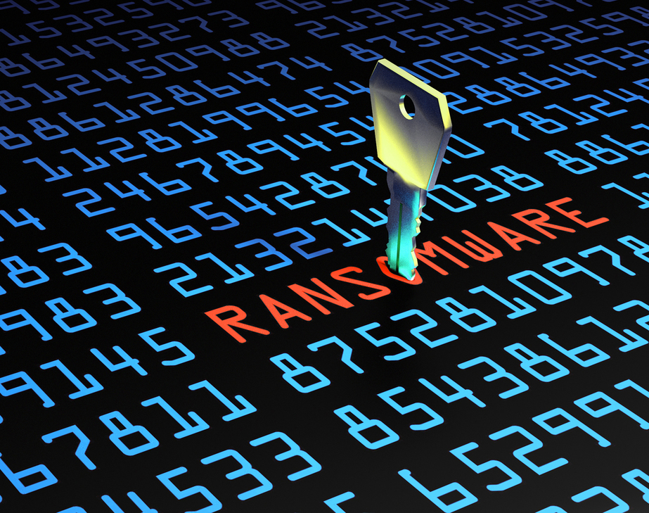
Ransomware
Ransomware is a form of malware that encrypts a victim's files. The attacker then demands a ransom from the victim to restore access to the data upon payment. Users are shown instructions for how to pay a fee to get the decryption key.

Slide 9

Adware
Adware, or advertising supported software, is software that displays unwanted advertisements on your computer. ... Adware uses the browser to collect your web browsing history in order to 'target' advertisements that seem tailored to your interests.

Slide 10

Spyware
Spyware is unwanted software that infiltrates your computing device, stealing your internet usage data and sensitive information. Spyware is classified as a type of malware — malicious software designed to gain access to or damage your computer, often without your knowledge.

Slide 11
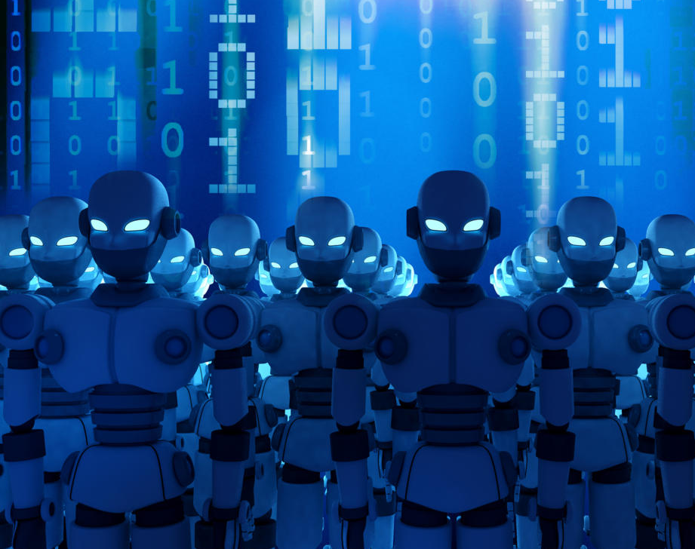
Botnet
A botnet is several Internet-connected devices, each of which is running one or more bots. Botnets can be used to perform Distributed Denial-of-Service (DDoS) attacks, steal data, send spam, and allow the attacker to access the device and its connection.

Slide 12

Crypter
A crypter is a type of software that can encrypt, obfuscate, and manipulate malware, to make it harder to detect by security programs. It is used by cybercriminals to create malware that can bypass security programs by presenting itself as a harmless program until it gets installed.

Slide 13
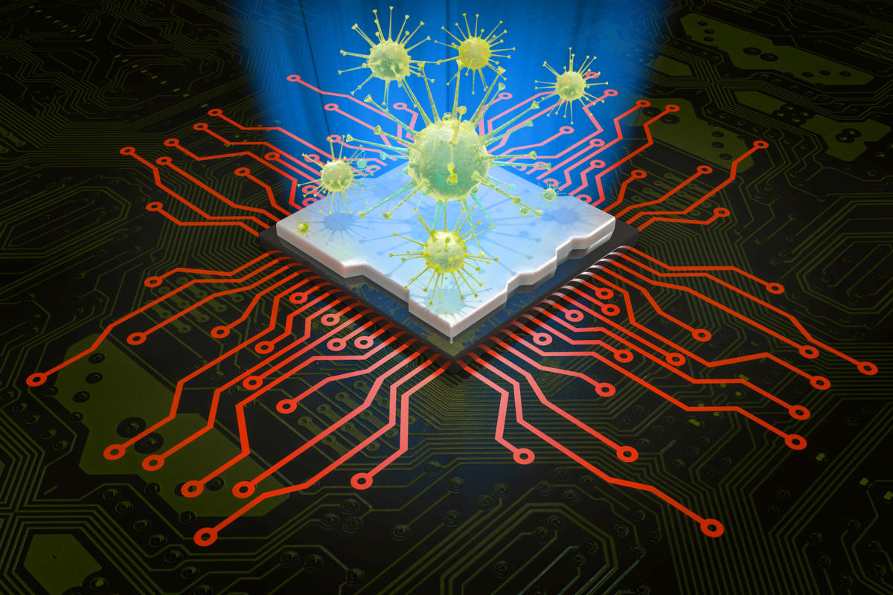
Virus vs Worms
Virus
Worms
Viruses must be triggered by the activation of their host.
Only after the host file is activated, can the virus run, executing malicious code and replicating to infect other files on your system.
Worms are stand-alone malicious programs that can self-replicate and propagate independently as soon as they have breached the system.
Once a worm has entered your system, usually via a network connection or as a downloaded file, it can then run, self-replicate and propagate without a triggering event

Slide 14
Common Tricks Used by Attackers
Blackhat Search Engine Optimization
Social Engineering Click-Jacking
Spear phishing sites
Malwaretising
Compromised Legitimate websites
Drive by Downloads
Spam E-Mails
Reference Video : https://www.youtube.com/watch?v=JZOLa7_LShk

Slide 15

Thank you

